Slide 1


DEPARTMENT OF HEALTH
CENTRAL LUZON CENTER FOR HEALTH DEVELOPMENT
Bulacan and Pampanga
COVID-19 Data Reconciliation
June 22, 2021
Central Luzon Center for Health Development
Department of Health, Philippines

Slide 2
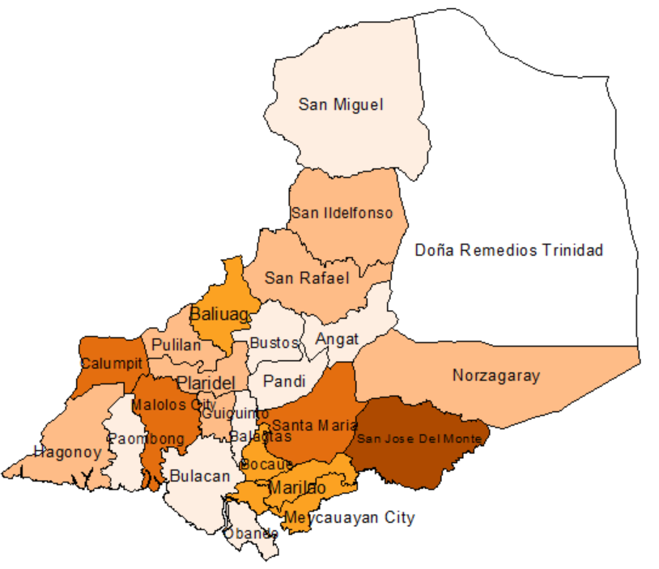



DISTRIBUTION MAP OF ACTIVE COVID-19 CASES Bulacan, as of 2021 June 16
COVID-19 CASES Bulacan, as of 2021 June 16
TOTAL | RECOVERIES | DEATHS | ACTIVE
48,560 | 46,129 (95%) | 946 (2%) | 1,485 (3%)
Central Luzon Center for Health Development
Department of Health, Philippines

Slide 3
COMPARISON OF COVID-19 CASES BY MUNICIPALITY/ CITY Bulacan, as of 2021 June 16
Mun/City | CUMULATIVE COVID KAYA DATABASE CONFIRMED CASES (2020- June 16,2021) | COVID KAYA Database CONFIRMED CASES (Jan 1- June 16, 2021) | PESU Database CONFIRMED CASES (Jan 1- June 16, 2021) | No. of Cases consistent with EB and PESU Database | No. of Confirmed Case for Verification/ Validation
 |  |  |  |  | EB with PESU | PESU with EB
ANGAT | 870 | 754 | 698 | 539 | 180 | 190
BALAGTAS (BIGAA) | 1,306 | 888 | 896 | 814 | 151 | 157
BALIUAG | 2,589 | 1,934 | 1,435 | 1,257 | 522 | 80
BOCAUE | 2,556 | 1,829 | 934 | 1,065 | 636 | 86
BULACAN | 1,373 | 841 | 720 | 743 | 257 | 110
BUSTOS | 666 | 513 | 362 | 260 | 253 | 101
CALUMPIT | 1,356 | 1,133 | 957 | 874 | 261 | 84
CITY OF MALOLOS (CAPITAL) | 4,543 | 3,322 | 3,276 | 2,640 | 464 | 542
CITY OF MEYCAUAYAN | 4,155 | 3,011 | 1,977 | 1,752 | 1,244 | 447
CITY OF SAN JOSE DEL MONTE | 7,030 | 4,676 | 3,346 | 3,043 | 1,866 | 496
DOÑA REMEDIOS TRINIDAD | 54 | 43 | 62 | 60 | 15 | 4
GUIGUINTO | 2,280 | 1,544 | 1,303 | 1,176 | 363 | 143
HAGONOY | 1,006 | 742 | 549 | 480 | 257 | 68
Central Luzon Center for Health Development
Department of Health, Philippines

Slide 4
COMPARISON OF COVID-19 CASES BY MUNICIPALITY/ CITY Bulacan, as of 2021 June 16
Mun/City | CUMULATIVE COVID KAYA DATABASE CONFIRMED CASES (2020- June 16,2021) | COVID KAYA Database CONFIRMED CASES (Jan 1- June 16, 2021) | PESU Database CONFIRMED CASES (Jan 1- June 16, 2021) | No. of Cases consistent with EB and PESU Database | No. of Confirmed Case for Verification/ Validation
 |  |  |  |  | EB with PESU | PESU with EB
MARILAO | 3,758 | 2,485 | 1,782 | 1,730 | 775 | 245
NORZAGARAY | 998 | 670 | 415 | 549 | 131 | 45
OBANDO | 1,066 | 700 | 586 | 486 | 211 | 122
PANDI | 888 | 634 | 482 | 459 | 181 | 59
PAOMBONG | 567 | 442 | 409 | 368 | 61 | 34
PLARIDEL | 1,678 | 1,204 | 1,102 | 1,011 | 99 | 115
PULILAN | 1,477 | 1,149 | 1,033 | 896 | 197 | 96
SAN ILDEFONSO | 1,136 | 985 | 486 | 340 | 212 | 122
SAN MIGUEL | 850 | 688 | 341 | 321 | 336 | 23
SAN RAFAEL | 1,112 | 865 | 756 | 652 | 211 | 148
STA. MARIA | 5,067 | 3,927 | 2,845 | 2,582 | 1,366 | 161
BLANK | 179 | 53 | - | - | - | -
BULACAN | 48,560 | 35,032 | 26,752 | 24,097 | 10,249 | 3,678
Central Luzon Center for Health Development
Department of Health, Philippines

Slide 5
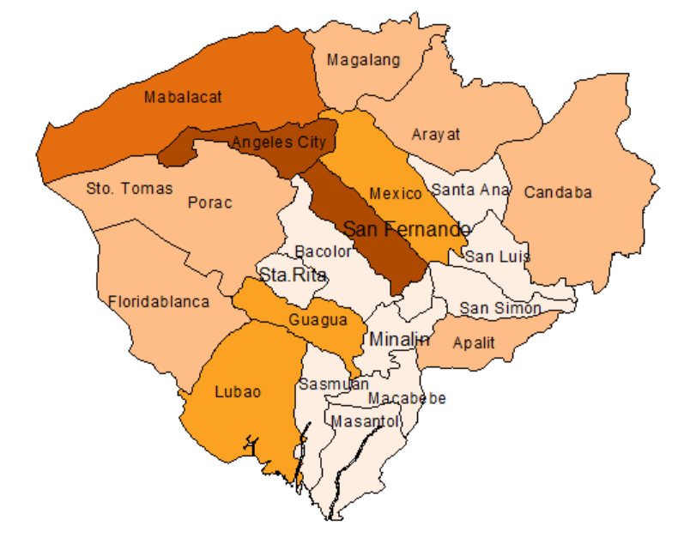
DISTRIBUTION MAP OF ACTIVE COVID-19 CASES Pampanga, as of 2021 June 18
COVID-19 CASES, Pampanga (with Angeles City), as of 2021 June 18
TOTAL | RECOVERIES | DEATHS | ACTIVE
30,761 | 28,561 (93%) | 972(3%) | 1,228(4%)
Central Luzon Center for Health Development
Department of Health, Philippines

Slide 6
CONFIRMED COVID-19 CASES BY MUNICIPALITY/ CITY Pampanga, as of 2021 June 18
Mun/City | COVID KAYA Database CONFIRMED CASES (2020- June 18, 2021) | PESU Database CONFIRMED CASES (2020- June 18, 2021) | No. of Cases consistent with EB and PESU Database | No. of Confirmed Case for Verification/ Validation
 |  |  |  | EB with PESU | PESU with EB
ANGELES CITY | 7,475 | 6,338 | 5,593 | 1,883 | 819
APALIT | 933 | 789 | 721 | 163 | 75
ARAYAT | 738 | 650 | 603 | 123 | 46
BACOLOR | 582 | 520 | 444 | 119 | 73
CANDABA | 838 | 735 | 693 | 131 | 43
CITY OF SAN FERNANDO (CAPITAL) | 5,964 | 5,228 | 4,927 | 881 | 239
FLORIDABLANCA | 979 | 842 | 719 | 211 | 91
GUAGUA | 1,413 | 1,125 | 1023 | 329 | 85
LUBAO | 1,047 | 937 | 822 | 174 | 111
MABALACAT CITY | 4,303 | 3,139 | 2784 | 1,243 | 242
MACABEBE | 447 | 419 | 385 | 62 | 32
MAGALANG | 907 | 840 | 738 | 139 | 98
Central Luzon Center for Health Development
Department of Health, Philippines

Slide 7
CONFIRMED COVID-19 CASES BY MUNICIPALITY/ CITY Pampanga, as of 2021 June 18
Mun/City | COVID KAYA Database CONFIRMED CASES (2020- June 18, 2021) | PESU Database CONFIRMED CASES (2020- June 18, 2021) | No. of Cases consistent with EB and PESU Database | No. of Confirmed Case for Verification/ Validation
 |  |  |  | EB with PESU | PESU with EB
MASANTOL | 179 | 160 | 140 | 33 | 23
MEXICO | 1,472 | 1,314 | 1182 | 240 | 128
MINALIN | 392 | 402 | 362 | 28 | 44
PORAC | 1,076 | 1,002 | 907 | 146 | 82
SAN LUIS | 245 | 232 | 206 | 33 | 24
SAN SIMON | 398 | 321 | 299 | 78 | 22
SANTA ANA | 379 | 355 | 315 | 56 | 39
SANTA RITA | 425 | 382 | 342 | 69 | 37
SANTO TOMAS | 345 | 298 | 268 | 62 | 27
SASMUAN (SEXMOAN) | 156 | 152 | 136 | 23 | 28
BLANK | 45 | 0 | 0 | 0 | 0
TOTAL | 30,738 | 26,180 | 23,609 | 6,226 | 2,408
Central Luzon Center for Health Development
Department of Health, Philippines

Slide 8
CONTACT TRACING AMONG CONFIRMED COVID-19 CASES Central Luzon, as of 2021 June 19
PROVINCE | CONFIRMED CASES (COVID KAYA) | CONFIRMED CASES (PESU) | CASES WHERE CONTACT TRACING WAS INITIATED | PERCENTAGE (Covid Kaya) | PERCENTAGE (PESU Database) | CLOSE CONTACTS IDENTIFIED | AVERAGE CLOSE CONTACTS IDENTIFIED PER CONFIRMED CASE
 |  |  |  | (%) | (%)
BULACAN | 49,112 | 38,325 | 37,980 | 77.33 | 99.10 | 154,300 | 4
PAMPANGA | 30,922 | 26,420 | 30,922 | 100.00 | 117.00 | 90,202 | 3
Central Luzon Center for Health Development
Department of Health, Philippines

Slide 9
COVID-19 SURVEILLANCE SYSTEM
Central Luzon Center for Health Development
Department of Health, Philippines

Slide 10
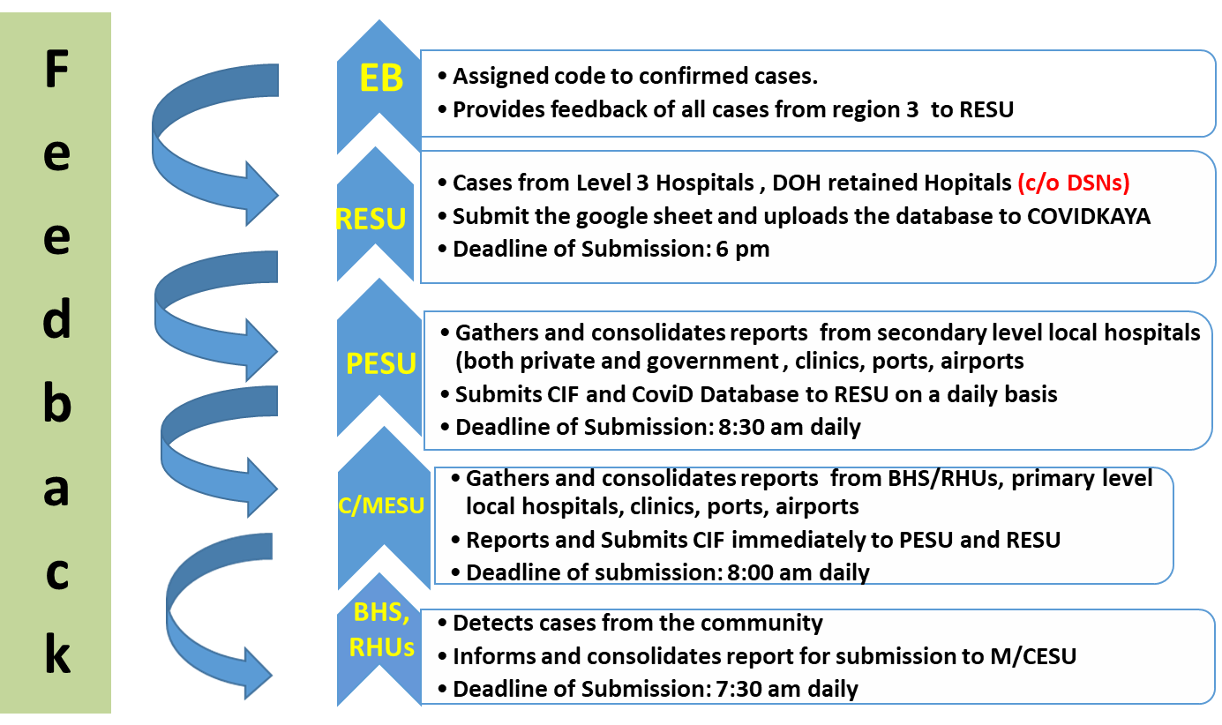

Flow of Reporting of COVID-19 Cases CL-CHD
Regional Epidemiology and Surveillance Unit – Central Luzon

Slide 11
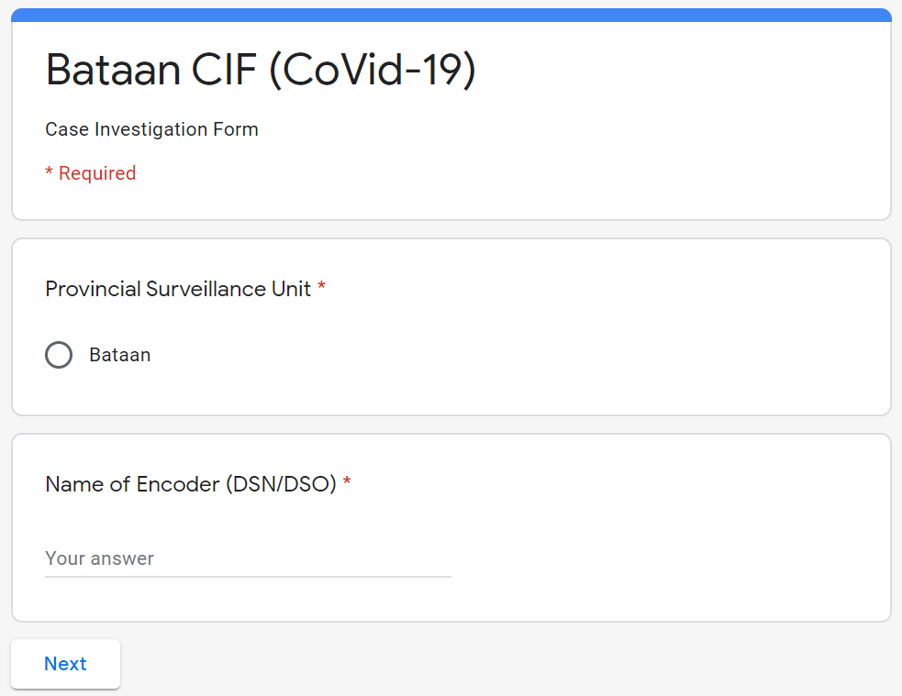
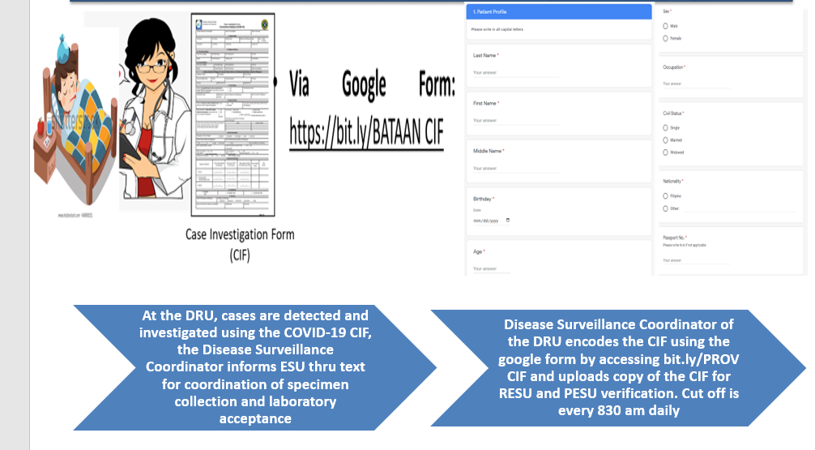

REPORTING PROCESS : CASES
Google Form:
https://bit.ly/bataanCIF
Regional Epidemiology and Surveillance Unit – Central Luzon

Slide 12


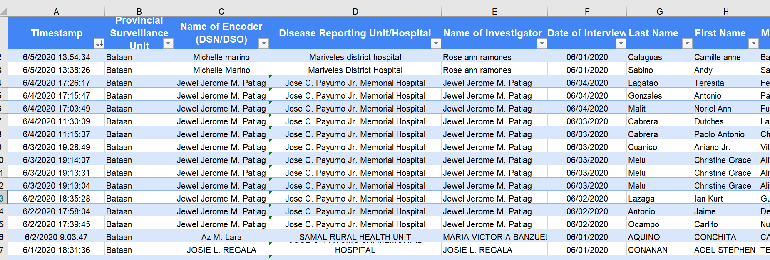
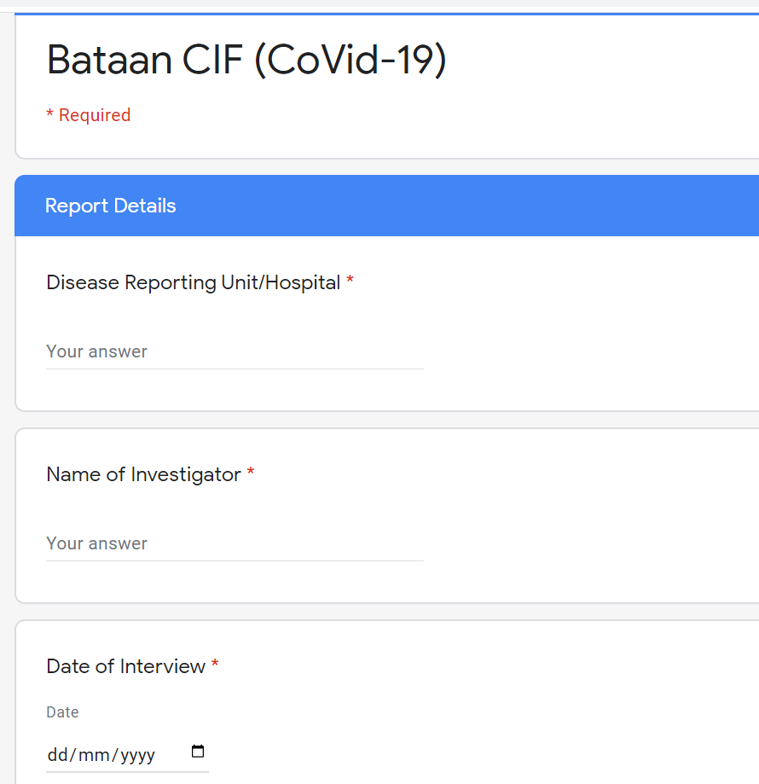
CIFs encoded in the google form goes straight to the database in excel form
Regional Epidemiology and Surveillance Unit – Central Luzon

Slide 13
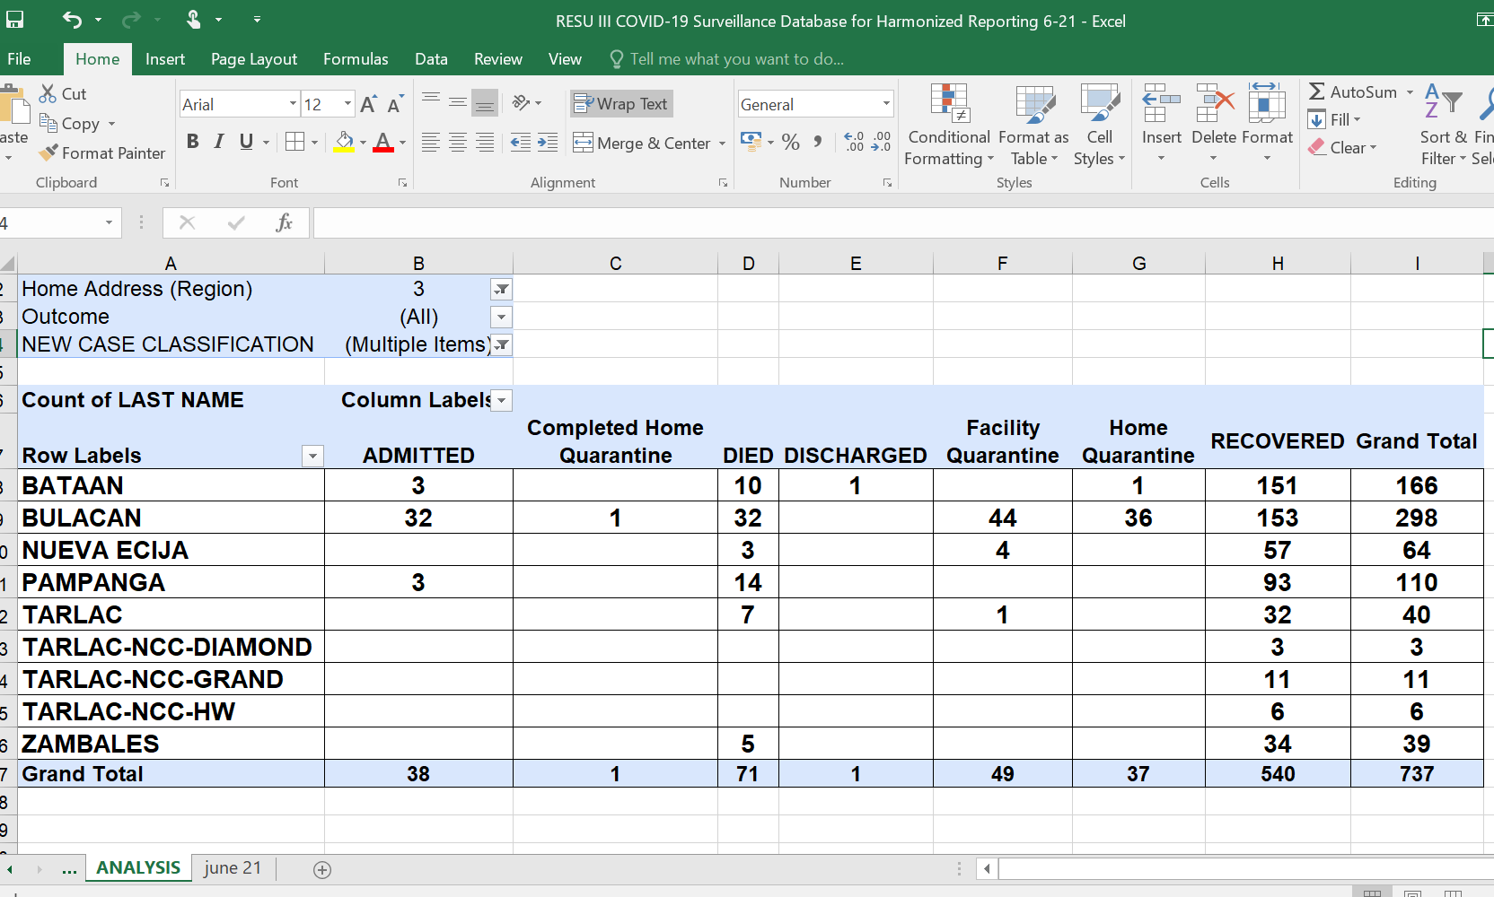
Regional Epidemiology and Surveillance Unit – Central Luzon

Slide 14
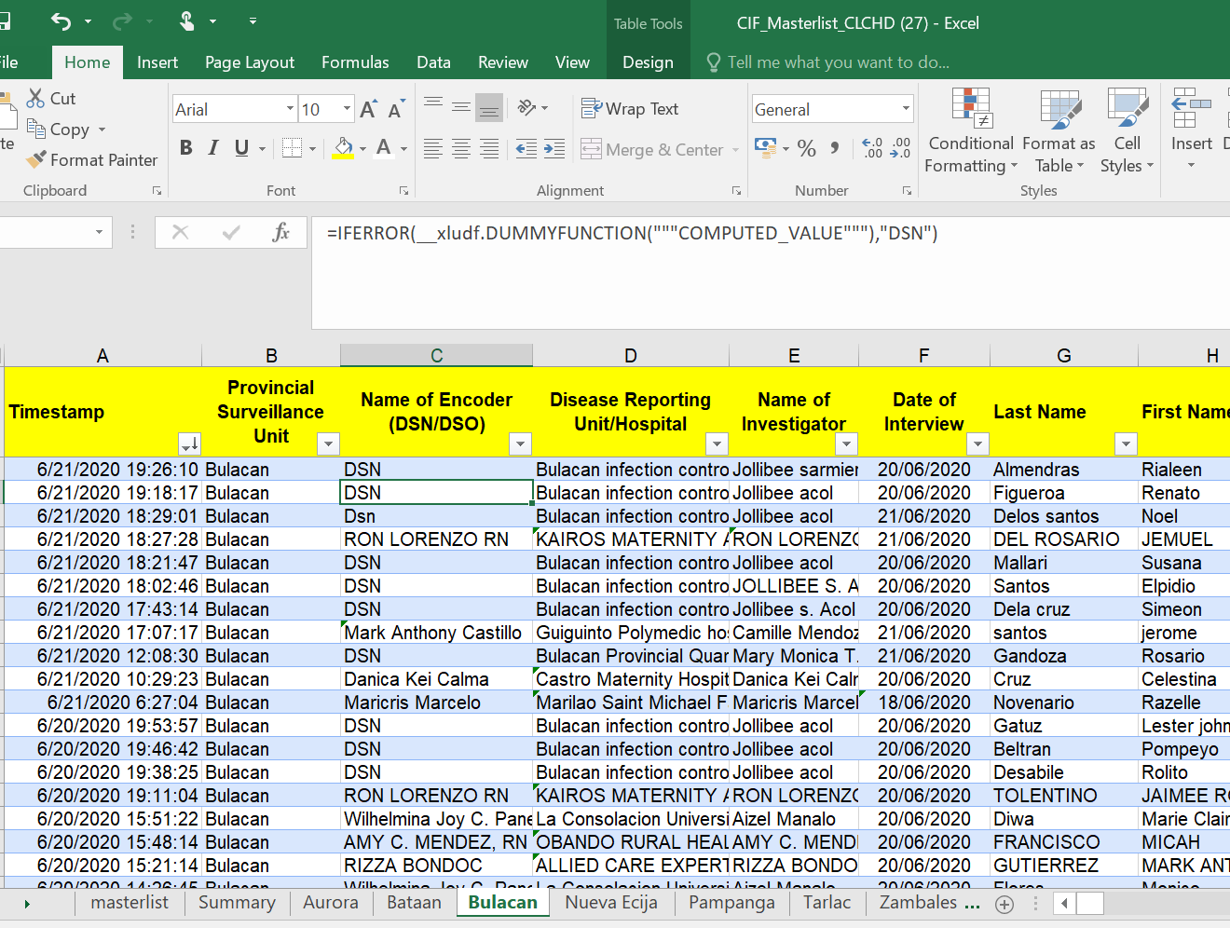
DATABASE: BULACAN
Cases are immediately reported/encoded
Regional Epidemiology and Surveillance Unit – Central Luzon

Slide 15
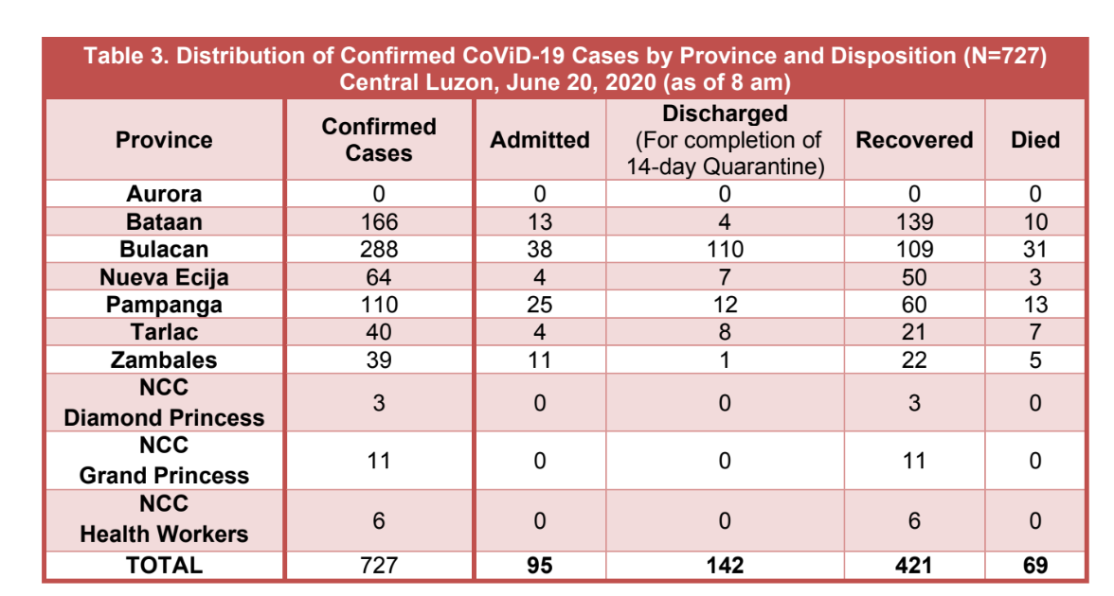
Provincial and Regional Disease Surveillance Nurses in coordination with the PESU and RESU consolidates, cleans and analyzes data daily for the update reports to be submitted to our ICS Planning Section Team for RDs approval and submission to the DOH Central Office, RTF and dissemination to stakeholders
- The RESU IT and Regional DSN uploads the data to the COVID-KAYA App daily every 6pm
Regional Epidemiology and Surveillance Unit – Central Luzon

Slide 16
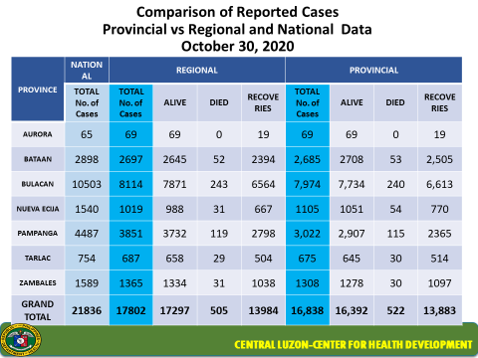

Slide 17
ISSUES & CONCERNS
PROVINCE | ISSUES | PROPOSED ACTIONS | REMARKS
BULACAN | DATA DISCREPANCY DATABASE SUBMISSION FROM PESU TO RESU (by request) Database submission of COVID-19 Feedback system COVID-KAYA to PESU to LESU (bottleneck) Lack manpower at the LGU/LESU to conduct verification of cases (as per PESU) DSOs deployed are also given function other than Disease Surveillance PESU | RESU Deployed DSOs and HPOs at the PHO/PESU will augment Mun Cities with high data discrepancies, just ensure that activities will be focused reconciling data discrepancies at these LGUs CL-CHD to issue a memo regarding COVID-19 case reporting by our LESU to PESU to RESU PESU to submit database to RESU via email daily | PESU agrees with the proposed - DILG reminds LGUs that deployed staff are just augmentation - DILG requested for a letter for immediate reporting to be complied by our DRUs / LGUs (submission of database by PESUs to RESU)
Central Luzon Center for Health Development
Department of Health, Philippines

Slide 18
ISSUES & CONCERNS
PROVINCE | ISSUES | PROPOSED ACTIONS | REMARKS
PAMPANGA | DATA DISCREPANCY Lack of manpower at the LGU/LESU, no personnel focused on ES activities Feedback mechanism RESU to PESU RESU sends daily to PESU through our deployed HRH to PESU TIMELINE of follow-up by RESU to PESU is daily through our RESU deployed PESU DSO PESU DSO cascades data for validation to C/MESU, however not all are immediately done due to conflicting activities ( COVID-19 vaccination) | RESU Deployed DSOs and HPOs at the PHO/PESU will augment Mun Cities with high data discrepancies, just ensure that activities will be focused reconciling data discrepancies at these LGUs CL-CHD to issue a memo regarding COVID-19 case reporting by our LESU to PESU to RESU | DMO IV - Agree with the proposed action PESU agrees with the proposed - DILG reminds LGUs that deployed staff are just augmentation - DILG requested for a letter for immediate reporting to be complied by our DRUs / LGUs (submission of database by PESUs to RESU)
Central Luzon Center for Health Development
Department of Health, Philippines

